Slide 1
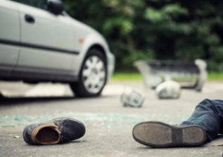
Pedestrian violation-traffic violation analysis
Sayaka Berkley

Slide 2
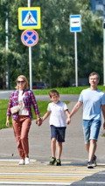
Introduction
Data : dataMontgomery
https://data.montgomerycountymd.gov/Public-Safety/Pedestrian-Violations-ONLY-Traffic-Violations-Rela/esfb-k7mv/about_data
9,334 rows
43 columns
Daily base update

Slide 3
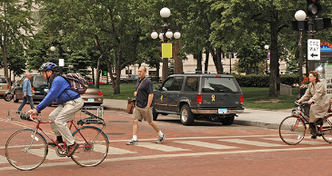
Data analysis plan
Map visualization
Heat map of violation types
Differences by race, age, etc.?
Location of violations
Arrest type
Date of stop
Is this just a place with more violators, or does it involve racism, etc.?
Are there areas, days, or times when these violations are more likely to occur?
Are there differences based on race or other factors? etc., I wanted to analyze the data to avoid trouble as much as possible, as no one wants to be involved in an accident.

Slide 4

Thank you
Sayaka Berkley
sberkley@montgomerycollege.edu

